Slide 1


English 8
UNIT 1 . LEISURE ACTIVITIES
PERIOD 3: A CLOSER LOOK 1
Welcome to our class
Teacher: Nguyen Thi Hien
Long Bien Secondary school

Slide 2
WARM UP
Other leisure activities
Watching TV
Reading
What do people do in their leisure time ?
Cooking
Cycling
Doing sports
and exersise
Using the computer
for leisure
Socialising and communicating

Slide 3

I. New words:
- socialise (v) :
Giao lưu, giao tiếp để tạo mối quan hệ
- Communicate (v):
Giao tiếp
- pie chart (n) :
biểu đồ hình tròn

Slide 4
1. Look at the pie chart on leisure activities in the USA.
LEISURE TIME ON AN AVERAGE DAY
Relaxing and thinking
(17 minutes)
Other leisure activities
(18 minutes)
Using the computer
(25 minutes)
Watching TV
(2.8 hours)
Doing sports and exercise
(19 minutes)
Reading
(20 minutes)
TOTAL LEISURE AND SPORTS TIME = 5.1 HOURS
Socialising and communicating
(39 minutes)

Slide 5
1. Look at the pie chart and answer the questions. (Ex. 1/p.8)
How much leisure time did people in the US have on an average day in 2012?
…………………………………………………………………………….
2. What did they do in their leisure time?
……………………………………………………………………………..
3. What were the three most common activities?
……………………………………………………………………………..
5.1 hours.
Reading, watching TV, using computers, …
Watching TV, socialising and communicating, and using the computer.

Slide 6
2. Complete the table with information from the pie chart. (Ex. 2/p.8)
Name of activity | Verb
Relaxing | relax
Thinking think
Using use
Doing do
Watching watch
Reading read
Socialising socialise
Communicating communiate

Slide 7
3. Look at the words. Match them to the category labels.
(Ex. 3/p.8)
1. skateboarding, football, badminton
3. the news, a reality show, a comedy
2. a novel, poetry, a magazine
6. going to local performances, visiting museums.
4. a new language, a skill
5. collecting stamps, making origami
7. visiting relatives, going shopping, doing DIY
8. texting, going to the cinema, hanging out
a. Learning something interesting
b. reading
c. Spending time with family
d. Having hobbies
e. Playing sports
f. Watching TV
g. Socialising with friends
h. Going to cultural places

Slide 8
Discuss: (Ex. 4/p.8)
1. How much time do you spend a day on leisure activities?
- One hour
2. What are the three activities that you do the most?
- Watching TV, reading, playing sports.

Slide 9

II. PRONUNCIATION
Clusters: /br/ or /pr/

Slide 10

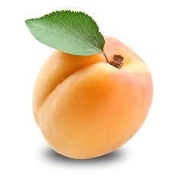
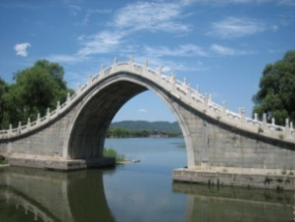
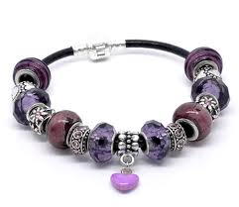
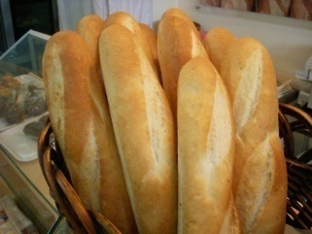
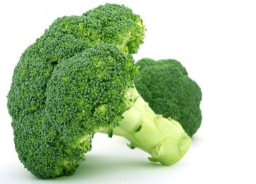
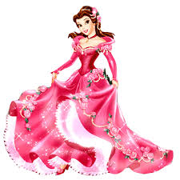
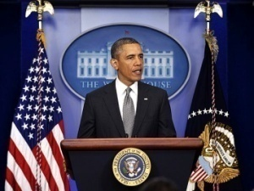

1. Complete the words under the pictures with /pr/ or /br/.
(Ex. 1/p.8)
br
br
2. ____ ridge
3. ___acelet
pr
br
4._____ead
1. a ___icot
pr
pr
pr
5. ___incess
6._____ esident
7. ___esent
8. ___occoli
br

Slide 11
2. Listen and repeat. (Ex. 1/p.8)
She loves making apricot jam.
My dad likes making bread in his free time.
Hen is our club president.
Mai keeps all her bracelets in a beautiful bags.
You will need a brush if you want to paint your room.
This is a wonderful present. Thanks so much!

Slide 12
III. AT HOME
Practice Clusters /br/ or /pr/ again.
Answer the questions in Ex. 4/p.8 / textbook.
Be ready for A CLOSER LOOK 2.

